Slide 1
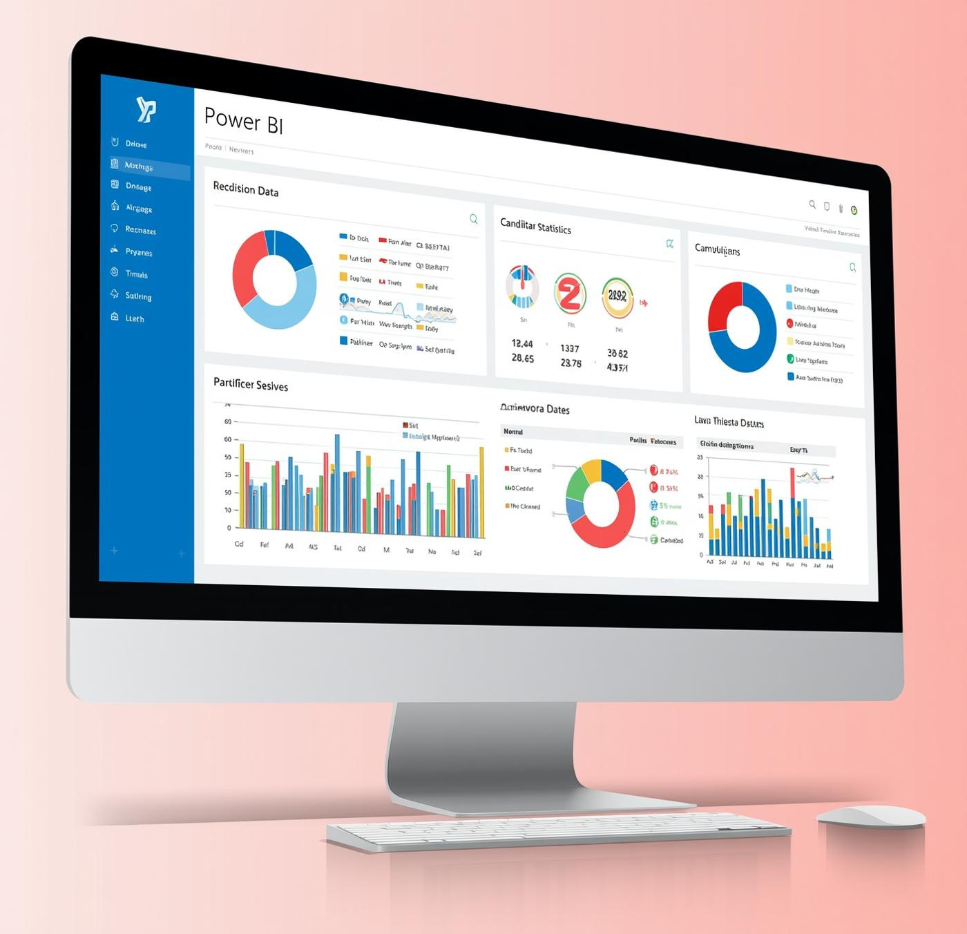
ElectViz: Election Data Visualization
for Media
PRESENTED TO
PRESENTED BY
Infosys Team
K.Srilakshmi Sowjanya

Slide 2

Objective
  To develop a real-time, interactive election data visualization system using Power BI.
  To provide media organizations and analysts with comprehensive insights on election outcomes.
  To enhance understanding of voter demographics, candidate performance, and party-wise statistics.
PURPOSE OF REAL-TIME VISUALIZATION
ElectViz aims to provide efficient, data-driven insights for media.

Slide 3

Problem Statement
  Traditional election reporting lacks visual depth and interactivity.
  Manual data analysis is time-consuming and prone to errors.
  Difficulty in interpreting large datasets such as candidate details, vote shares, and regional variations.
CHALLENGES IN CURRENT REPORTING METHODS
Many reports lack interactivity and real-time insights.

Slide 4

ElectViz Solution
  ElectViz automates the visualization of complex election data.
  Integrates multiple data sources to provide unified dashboards.
  Offers visual insights like:
  State-wise and party-wise winner distribution.
  Gender, age, and education demographics.
  Correlation between candidate wealth and criminal records.
  Voting patterns by type and constituency.

Slide 5
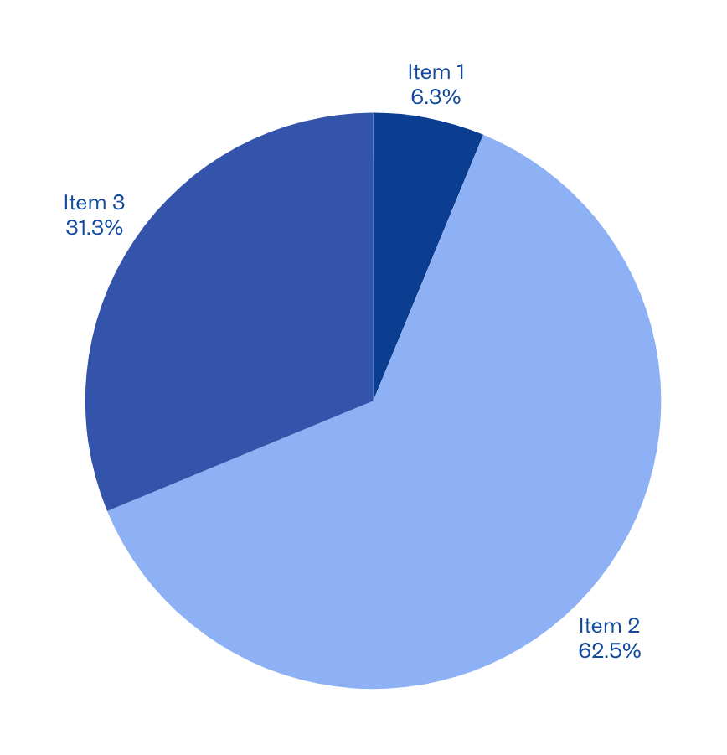
Key Insights
  Total Candidates: 2263 | Total Winners: 539
  Average Age: 52.27 | Average Assets: ₹133.3M
  Top States: Uttar Pradesh, Maharashtra, West Bengal
  Party Performance: BJP secured the most seats.
  Demographics: 85.9% male and 14.1% female winners.
  Education: Majority are graduates and postgraduates.
  Correlation: Wealthier candidates often face more criminal cases.
Interactive data visualization enhances election analysis.

Slide 6
Advantages of ElectViz
SIMPLIFICATION
ElectViz provides user-friendly analytics for easy understanding.
  Simplifies complex election data through interactive visuals.
  Enables quick comparison across states, parties, and demographics.
  Enhances accuracy and decision-making for journalists and analysts.
  Provides dynamic filtering and real-time updates.
SPEED
Users can access insights quickly, enhancing decision-making efficiency.
REAL-TIME UPDATES
Stay informed with live data, reflecting the latest trends.

Slide 7
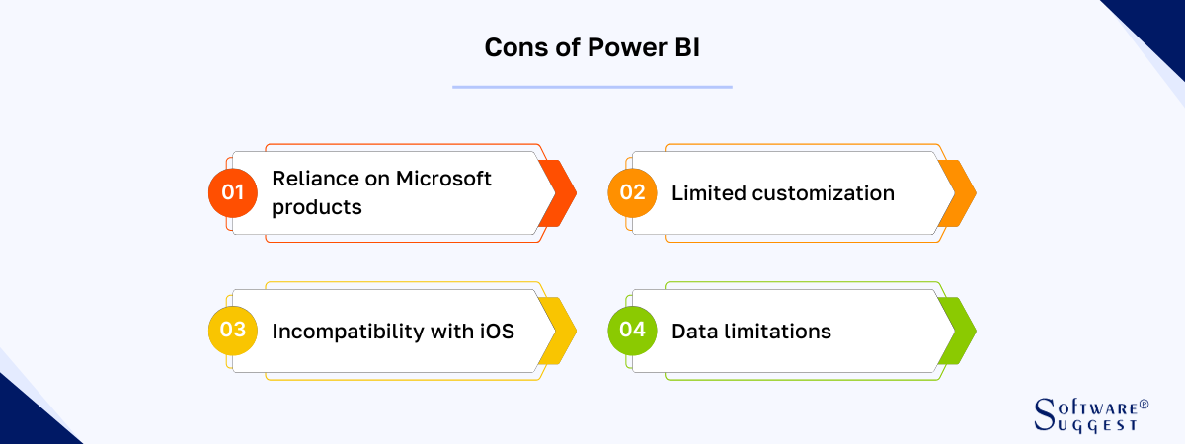
Disadvantages
  Relies heavily on data accuracy from external sources.
  Performance may lag with very large datasets.
  Limited offline functionality.
  Requires user training to interpret complex visuals.
DATA DEPENDENCY IN ELECTVIZ
ElectViz relies heavily on accurate data quality.

Slide 8
Challenges Faced
DATA CLEANING
Ensuring accuracy required extensive data cleansing efforts.
  Data cleaning and transformation for consistency.
  Managing large datasets and Power BI performance optimization.
  Designing clear and clutter-free visuals.
  Balancing aesthetics with analytical depth.
MODEL BUILDING
Developing effective models took significant time and resources.
VISUALIZATION DESIGN
Crafting intuitive designs posed unique usability challenges.

Slide 9

Learnings from Internship
POWER BI
Gained expertise in data visualization and reporting tools.
DATA MODELING
Developed skills in structuring and organizing data effectively.
STORYTELLING
Learned to communicate insights through compelling narratives.

Slide 10

THANK YOU!

